Slide 1
Concussion: A College Faculty Perspective
Justin Farr, Ed. D., ATC
Notes:
Welcome and thank you to everyone for coming.
After learning that our institution was improving policies regarding our treatment of student concussions, I felt that it would be beneficial to our faculty to have the opportunity to hear why this topic is so important.

Slide 2
Objectives
Define Concussion
How it happens and how often.
Why Concussions should matter to faculty
What are the symptoms and how they affect learning
How should we return students to the classroom

Slide 3
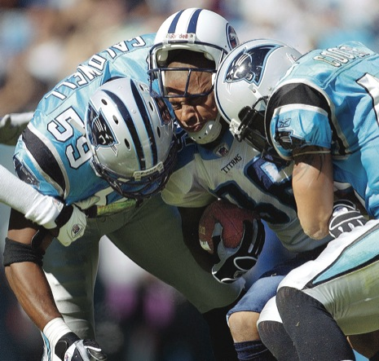
What is a Concussion?
It is not a “dinger” or a “bell ringer”
Concussion is an injury to the brain
Defined as: “a complex pathophysiological process affecting the brain, induced by biomechanical forces” (McCrory et al., 2013)
Considered the “invisible injury”
“acute symptoms largely reflect a functional disturbance rather than a structural injury and, as such no abnormality is seen on standard structural neuroimaging studies” (McCrory et al., 2013)
Notes:
-Dinger and bell ringer are outdated terms that were used for several years in both sideline practice and by coaching staffs to identify what we know as a head injury or concussion.
-Today we know that a concussion is an injury to the brain.
-Discuss definition
-Concussions are the invisible injury because you cannot see the damage done to the injured body part.
-Avocado example
-Black spots in an avocado
-You cannot tell from the outside that the fruit has over-ripened.
-Neural synapses are damaged and do not always display structural damage.

Slide 4
Occurrence of Concussion
The number of reported concussions has increased since 2005 (Rosenthal, J., 2014).
“National High School Athlete Concussion Rates From 2005-2006 to 2011-2012”
American Journal of Sports Medicine
Notes:
-Display Charts from High School concussion rates
-What can we determine from this data?
-Are concussions truly occurring more often or is it an increase in reporting.

Slide 5
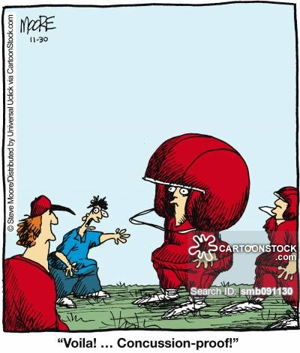
Why does it matter to faculty?
Concussions affect athletes:
Physically
Emotionally
Mentally
Sleep Disturbance
“Neurotransmitter and synaptic alterations are other mechanisms of neural dysfunction that occur in the absence of overt cell death and may contribute to acute and transient neurobehavioral impairments after concussion” (Givda & Hovsa, 2014)
Notes:
Concussions will affect four areas
Remember that this is a brain injury. This is going to affect each patient individually and much of this will be based on their biopsychosocial model.
How much support do they have at home?
Is this their first injury
Are they letting the team down

Slide 6
What are the symptoms and how do they affect students?
Physical:
Headache
Dizziness
Balance Problems
Nausea/Vomiting
Fatigue
Sensitivity to light
Physical symptoms are known to affect a student’s ability to focus and concentrate.

Slide 7
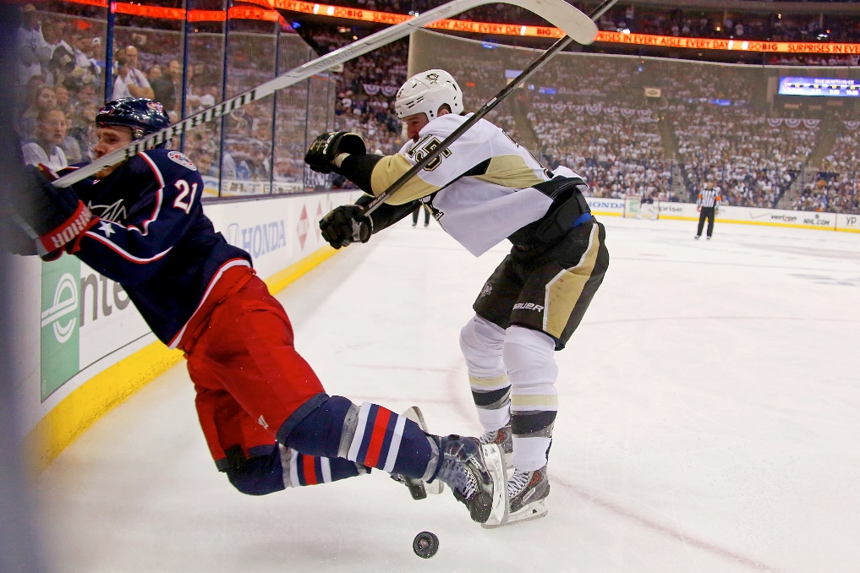
What are the symptoms and how do they affect students?
Cognitive:
Felling Foggy
Feeling Slowed Down
Difficulty Concentrating
Difficulty Remembering
Difficulty focusing
Cognitive and neurophysiological functions are impaired following a concussion (Pearce et al. 2014).

Slide 8
What are the symptoms and how do they affect students?
Emotional
Irritability
Sadness
Nervousness
Struggles with school work can cause students to become more frustrated than normal.

Slide 9
What are the symptoms and how do they affect students?
Sleep
Trouble Falling Asleep
Sleeping more than usual
Sleeping less than usual
Sleep changes can cause drowsiness and increase the inability to concentrate in the classroom.
Notes:
Know your students, this might be a student who falls asleep often anyway.
Does anything seem irregular
Keep in mind that their inability to sleep will affect their ability to concentrate and focus

Slide 10
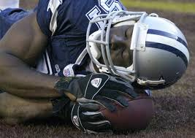
Accommodations
Absence from school or half day attendance.
Decreases activity by brain allowing for rest.
Avoidance of extensive technology use.
Technology makes the brain work hard, thus not allowing rest.
No participation in any physical activity.
Magnifies symptoms, increases the risk of second impact syndrome.
The key to any student recovering quickly is REST!
Notes:
These will be outlined to you by team physicians
You don’t have to know all of the possible accommodations

Slide 11
I’ve heard of return to play; what about return to school?
According to Carson et al. (2014) “ in 44.7% of concussion cases, the patient returned to school too soon.”
5 total phases
Very similar to a graduated return to play (RTP) protocol
Allows for student to readjust slowly and at their own pace.

Slide 12
Phase One (No School)
Dependent on symptoms
This stage allows for most rest and healing to occur.
What might be recommended
No school
No unnecessary technology
No physical activity
Strict cognitive rest is not needed in those with mild concussion.
(Carson 2014), (McGrath 2010), (Irvine et al. 2017)

Slide 13
Phase Two (Half Day Attendance)
Symptoms have decreased to a manageable level.
Headaches are mild and less frequent.
Ability to concentrate is beginning to return
Still avoid tasks that increase or produce symptoms
What might be recommended
Focus on core subjects
No physical activity
Emphasize in school learning
Listen to student

Slide 14
Phase Three (Full Day Attendance w/ Accommodations)
Symptoms are almost gone
Student may still be triggered
What might be recommended
Limit to one test per day
Emphasize in class learning
Gradual increase of homework
No physical activity
Listen to the student

Slide 15
Phase Four (Full Day W/O Accommodations)
Mild or no symptoms
What might be recommended
Plan to makeup all missed work
No physical activity until released
RTP protocol completed

Slide 16
Phase Five (Full school and Extracurricular)
No symptoms
Must complete RTP protocol prior to retuning to full activity.

Slide 17
What Symptoms to Look For
Dizziness
Headaches
Nausea
Inability to Concentrate
Fatigue or drowsiness

Slide 18
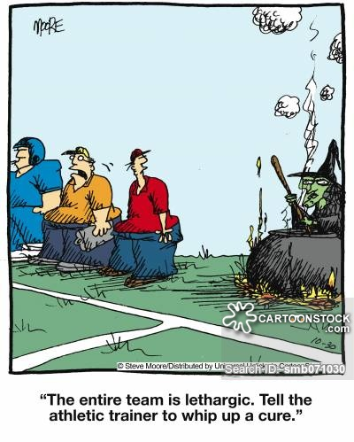
Take Away
Concussions must be handled as a team approach.
Medical Staff
Faculty
Student
Coaches
STAY POSITIVE and DON’T RUSH
RTP and RTS are crucial in proper healing

Slide 19
References
Broglio, S. P., Cantu, R. C., Gioia, G. A., Guskiewicz, K. M., Kutcher, J., Palm, M., & McLeod, T. C. V. (2014). National athletic trainers’ association position statement: Management of sport concussion.Journal of Athletic Training, 49(2), 245–265. doi:10.4085/1062-6050-49.1.07
Carson, J. D., Lawrence, D. W., Kraft, S. A., Garel, A., Snow, C. L., Chatterjee, A., … Frémont, P. (2014). Premature return to play and return to learn after a sport-related concussion: Physician’s chart review. Canadian Family Physician, 60(6), e310–e315.
CDC. (2015, February 16). What is a concussion?. Retrieved February 10, 2016, from http://www.cdc.gov/headsup/basics/concussion_whatis.html
Concussions: Return-To-Sport and Return-To-Learn Considerations. (2015). New York Family Medicine News, 31-34 4p
Courson, R., Goldenberg, M., Adams, K. G., Anderson, S. A., Colgate, B., Cooper, L., … Turbak, G. (2014). Inter-association consensus statement on best practices for sports medicine management for secondary schools and colleges. Journal of Athletic Training, 49(1), 128–137. doi:10.4085/1062-6050-49.1.06
Dr. Julian Bailes: Risk of CTE does not equate to younger levels. (2015, October 12). Retrieved February 12, 2016, from http://usafootball.com/blogs/heads-up-football/post/11228/dr.-julian-bailes%3A-risk-of-cte-does-not-equate-to-younger-levels

Slide 20
References
DrewCHallett (2014, September 27). Shane Morris concussion & Hoke Reinserts him Retrieved from https://youtu.be/N1mIcYz-DM8
Gardner, A., Iverson, G. L., & McCrory, P. (2013). Chronic traumatic encephalopathy in sport: A systematic review. British Journal of Sports Medicine, 48(2), 84–90. doi:10.1136/bjsports-2013-092646
Giza, C. C., & Hovda, D. A. (2014). The new Neurometabolic cascade of concussion. Neurosurgery, 75, S24–S33. doi:10.1227/neu.0000000000000505
Hutchison, M. G., Comper, P., Meeuwisse, W. H., & Echemendia, R. J. (2013). A systematic video analysis of national hockey league (NHL) concussions, part I: Who, when, where and what?. British Journal of Sports Medicine, 49(8), 547–551. doi:10.1136/bjsports-2013-092234

Slide 21
References
Johnson, L. S. M. (2012). Return to play guidelines cannot solve the football-related concussion problem. Journal of School Health, 82(4), 180–185. doi:10.1111/j.1746-1561.2011.00684.x
McGrath, N. (2010). Supporting the student-athlete’s return to the classroom after a sport-related concussion. Journal of Athletic Training, 45(5), 492–498. doi:10.4085/1062-6050-45.5.492
McKee, A. C., Cantu, R. C., Nowinski, C. J., Hedley-Whyte, E. T., Gavett, B. E., Budson, A. E., … Stern, R. A. (2009). Chronic traumatic Encephalopathy in athletes. Journal of Neuropathology and Experimental Neurology, 68(7), 709–735. doi:10.1097/nen.0b013e3181a9d503

Slide 22
References
Omalu, B. (2015, December 7). Don’t let kids play football. The Opinion Pages. Retrieved from http://www.nytimes.com/2015/12/07/opinion/dont-let-kids-play-football.html
Pearce, A. J., Hoy, K., Rogers, M. A., Corp, D. T., Davies, C. B., Maller, J. J., & Fitzgerald, P. B. (2015). Acute motor, neurocognitive and neurophysiological change following concussion injury in Australian amateur football. A prospective multimodal investigation. Journal of Science and Medicine in Sport, 18(5), 500–506. doi:10.1016/j.jsams.2014.07.010
Rose, S. C., McNally, K. A., & Heyer, G. L. (2015). Returning the student to school after concussion: What do clinicians need to know?. Concussion. doi:10.2217/cnc.15.4

Slide 23
References
Rosenthal, J. A., Foraker, R. E., Collins, C. L., & Comstock, R. D. (2014). National high school athlete concussion rates from 2005-2006 to 2011-2012. The American Journal of Sports Medicine, 42(7), 1710–1715. doi:10.1177/0363546514530091
SPORTS MEDICINE POLICY- PROTOCOL RELATED TO CONCUSSIONS PROTOCOL RELATED TO CONCUSSIONS AND CONCUSSED STUDENT-ATHLETES FOR AND CONCUSSED STUDENT-ATHLETES FOR ALL INTERSCHOLASTIC ATHLETICS IN THE ALL INTERSCHOLASTIC ATHLETICS IN THE COMMONWEALTH OF KENTUCK. (2013). . Retrieved from http://khsaa.org/sportsmedicine/concussion/concussion%20protocol.pd

Slide 24
References
Strauss, B. (2015, November 11). U.S. Soccer, resolving lawsuit, will limit Headers for youth players. Soccer. Retrieved from http://www.nytimes.com/2015/11/10/sports/soccer/us-soccer-resolving-lawsuit-will-limit-headers-for-youth-players.html?_r=0
U.S. Soccer provides additional information about upcoming player safety campaign. (2015, November 9). Retrieved February 11, 2016, from http://www.ussoccer.com/stories/2015/11/09/22/57/151109-ussoccer-provides-additional-information-about-upcoming-player-safety-campaign
ellen.campbell, & U.S. Department of Education. (2008). Joint guidance on the application of the family educational rights and privacy act (FERPA) and the health insurance portability and accountability act of 1996 (HIPAA) to student health records. Retrieved from http://www2.ed.gov/policy/gen/guid/fpco/doc/ferpa-hipaa-guidance.pdf

