Slide 1
From The Divine Comedy to the Big Bang Theory
Bringing the catholic intellectual tradition into the classroom

Slide 2
The Catholic Intellectual Tradition is an integral part of the TMU mission
Mission: “Inspired by the Catholic Intellectual Tradition, we challenge students of all faiths to examine the ultimate meaning of life, their place in the world, and their responsibility to others.”
Explication of Mission: “Our primary mission is to develop and sustain challenging undergraduate, graduate, and professional programs of study, marked by superior teaching and scholarship within the Catholic intellectual tradition.”
This Photo by Unknown Author is licensed under CC BY-SA

Slide 3
But what is the Catholic Intellectual Tradition (CIT)?
The CIT is sometimes described as “a 2,000 year ‘conversation’ between the Church and the world.
It is an ongoing and open dialogue that seeks to engage all people, cultures, and questions.
This has led to the creation of many beautiful texts, pieces of art and music, and discoveries about the world.
This Photo by Unknown Author is licensed under CC BY-SA

Slide 4
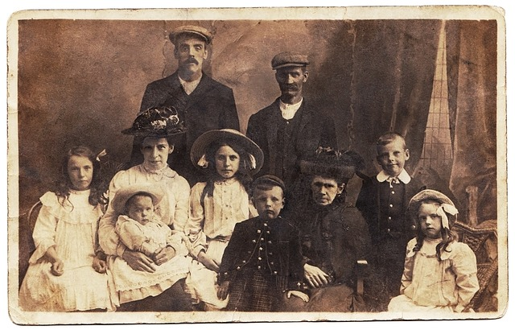
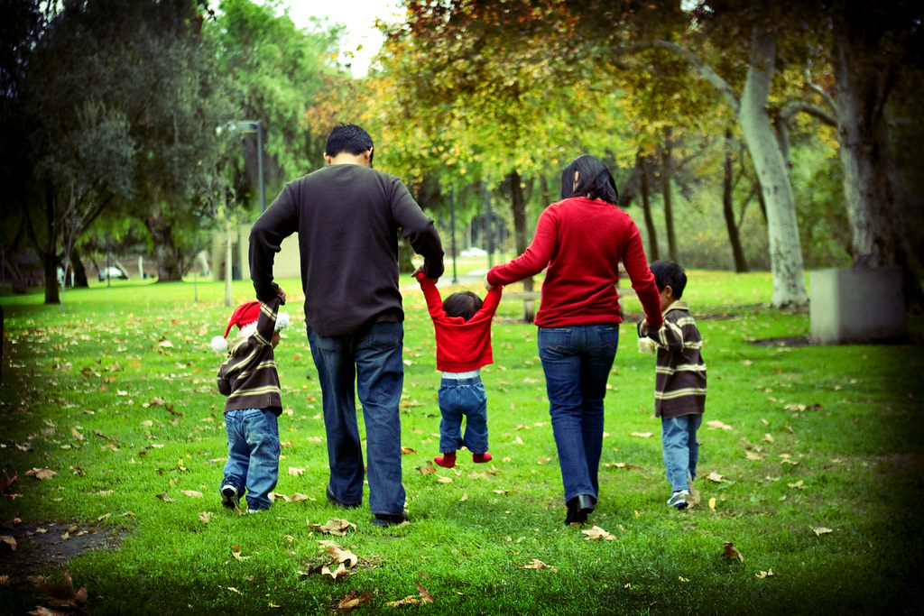
Catholic universities act as stewards of the CIT in two primary ways
Celebrating and sharing the treasures of the past.
Continuing the Catholic tradition of inquiry by pursuing the truth within one’s discipline in a way that embodies certain principles.
It is like passing on a “family tradition”: handing down photos, heirlooms and stories of the past; participating in an evolving story unfolding in the present.
This Photo by Unknown Author is licensed under CC BY-ND

Slide 5
How can we bring the CIT into the classroom?
Making explicit the aspects of the CIT that we are already incorporating.
Adding content.
Teaching all of our content in a way that embodies the principles of the Catholic tradition of inquiry.

Slide 6
EMBODYING THE PRINCIPLES OF THE CATHOLIC TRADITION OF INQUIRY
Faith and reason are in harmony.
An integrative perspective on knowledge.
A sacramental worldview.
Reverence for the dignity and communal nature of every human being.
Dialogical in nature.
The universe is intelligible and an integral part of our human nature is our desire to know the truth.

Slide 7
Creation & The Big Bang AN ILLUSTRATION

Slide 8
Faith and reason are in harmony.
Sharing that the theological explanation of creation and the scientific theory of the big bang are not in competition with each other. The study of science leads to ultimate questions which science itself cannot address. Faith leads to questions about the material world which science can address.
An integrative perspective on knowledge.
Different kinds of explanations that fit together in a larger whole.
“Why is the gift there?” example. Each discipline (sociology, economics, biology, theology) gives a different explanation that fit together into a greater whole.
A sacramental worldview.
Cultivating wonder.
Studying the Big Bang Theory can be an experience of God.

Slide 9
Reverence for the dignity and communal nature of every human being.
Treating every person in the classroom with respect; create a culture of belonging.
Potentially discuss the Catholic understanding of the human person as a unity of body and soul – the person is more than matter.
Intellectual community – modeling respect for dignity and inclusive community.
Dialogical in nature.
Encourage questions.
The universe is intelligible and an integral part of our human nature is our desire to know the truth.
Encourage students to dig deeper.
Potentially note the history of Western science and its Christian roots.

Slide 10
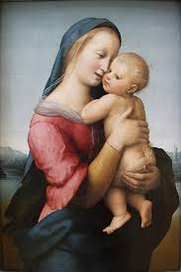
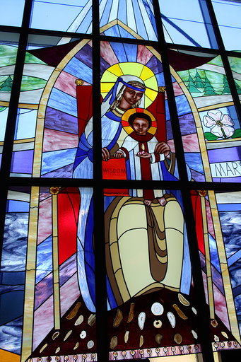
CONTENT: The Catholic Intellectual Tradition in Art
Studying the treasures of the past…
Studying contemporary works…
Raphael; Tempi Madonna
Sr. Emmanuel Pieper; Mary, Seat of Wisdom
Take the CIT challenge! Try to incorporate one text, work, or person from the CIT into your courses.

Slide 11
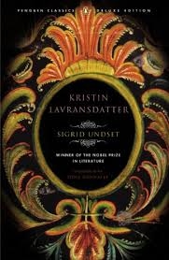
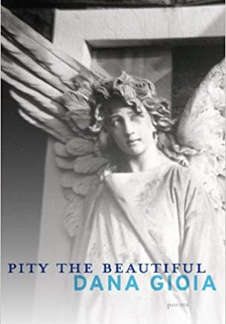
CONTENT: The Catholic Intellectual Tradition in Literature
Studying the treasures of the past…
Studying contemporary works…
Dante, Flannery O’Connor, Dostoevsky, Tolkien, Chesterton, Sigrid Undset
Joseph Pearce, Dana Gioia, Annabelle Mosley
Note: Many works by Catholic authors are not explicitly religious.

Slide 12
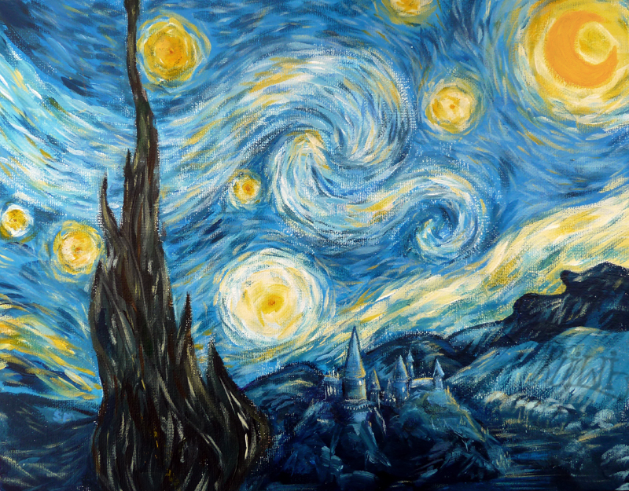
MAKE THE IMPLICIT EXPLICIT
You may already incorporate a person, work, or idea from the CIT; make an explicit connection for the students.
Draw out themes from the works you are already studying.
Walking to Listen.
Groundhog Day – make connections in unexpected places.
Starry Night – art as an experience of the transcendent.
Prayer; culture.

Slide 13
Implementing Core Outcome 3
Examine social issues with an awareness of Catholic tradition of justice

Slide 14
What is the Catholic tradition of justice?
Catholic Social Teaching (CST) = fruit of reflection on what the Catholic faith means for society and how one lives in the world.
Life and Dignity of the Person
Call to Family, Community, and Participation
Solidarity
Rights and Responsibilities
Option for the Poor and Vulnerable
The Dignity of Work and the Rights of Workers.
Care for God’s Creation.
Rooted in Scripture, Tradition, Reason, and Experience.

Slide 15
How can we bring CST into the classroom?
Making explicit the aspects of the CST that we are already incorporating.
Adding content.
Teaching all of our content in a way that embodies the principles of Catholic social teaching.

Slide 16
A FEW IDEAS…
Make an explicit connection to CST when you are addressing social injustice, social responsibility, dignity, or ethics in your course.
Incorporate a Catholic social teaching reading into one of your assignments about these topics. Encourage students to analyze a problem or solution in light of CST principles.
Here is a summary of the CST principles: http://www.usccb.org/beliefs-and-teachings/what-we-believe/catholic-social-teaching/seven-themes-of-catholic-social-teaching.cfm
Here is a list of the Church’s encyclicals: https://socialconcerns.nd.edu/content/cst-major-documents)
Here is a link to the Compendium of the Social Doctrine of the Church (a summary of all CST): http://www.vatican.va/roman_curia/pontifical_councils/justpeace/documents/rc_pc_justpeace_doc_20060526_compendio-dott-soc_en.html
Teach in a way that embodies CST. Foster a learning community that recognizes the dignity of each individual, encourage attention to social problems and solidarity with the less fortunate, teach and model good stewardship of resources, seek to attend to both the material and spiritual good of others.

Slide 17
FURTHER RESOURCES
Understanding and teaching the Catholic Intellectual Tradition: https://www.bc.edu/content/dam/files/top/church21/pdf/C21ResourceSPRING_2013_FINAL_web.pdf
Short videos on each principle of Catholic Social Teaching: https://www.crs.org/resource-center/CST-101?tab=life-and-dignity-of-the-human-person

