Slide 1
The Institute for Academic Excellence Peer Tutoring, & Academic Coaching

Slide 2
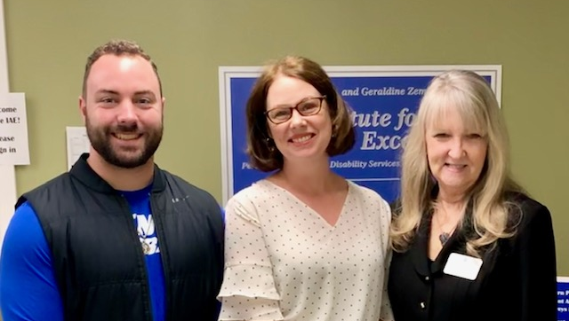
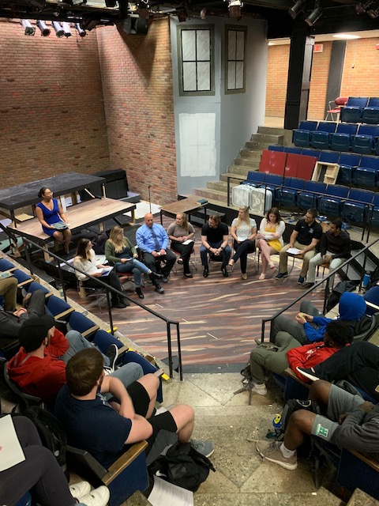
Dr. Anthony and Geraldine Zembrodt Institute for Academic Excellence
Includes traditional academic supports
Example innovations include
4C Scholar Society
Smarthinking 24/7 on-line tutoring
Professional academic coaching
Study Tables for all students
Walk-in and Individual tutoring sessions
Peer tutor training
Distinct student supports received for 18/19 = 1537
Notes:
Our next institute – the Dr. Anthony … IAE
Includes traditional academic supports including peer tutoring, academic coaching, strategy building around study skills, time management, and goal setting. In my role, my goal is to expand and strengthen our services to make them more visible, accessible, and effective for all TMU students.
4C Society— targets our “marvelous middle” students and focuses on the 4C’s (Character, Community, Career, and Classroom), which come from the ROI developed from the most recent strategic plan. Seniors in the program participate in a capstone project that highlights their personal ROI and experiences through the lenses of the 4Cs and graduate with 4C Scholar distinction.
Smarthinking tutoring— Our online tutoring platform is in place to support all TMU students, especially those taking online classes and in the TAP and Graduate programs, where it has become increasingly popular, with 75% of students using the service in TAP or Graduate programs, and an 86% increase in overall usage from 17/18 academic year.
Approximately 1537 touchpoints from IAE services in 18/19 academic year

Slide 3
The IAE currently has 2 academic coaches:
Barb Amato
Devon Fisher (student athletes)

Slide 4
Academic Coaching
Academic Coaches work directly with students to help with time management & organization strategies, campus resources, communication skills, and motivation.
Coaches also oversee Study Tables, present to classes, and offer workshops

Slide 5
The IAE offers FREE peer-to-peer tutoring in an array of general course subjects including:
Accounting & Economics
Sciences: Biology, A&P, Chemistry
Kinesiology & Exercise Science
CIS, Programming, and Excel
History
Psychology
Spanish
We are always looking to expand our team of peer tutors!

Slide 6
Peer Tutoring
Peer tutor qualifications:
At least a 3.0 GPA
B or higher in course for which they wish to tutor
2 faculty recommendations
Attend in-person training once per semester
Complete online tutor training in Canvas

Slide 7
New this semester!
The IAE is piloting WCOnline – an online scheduling platform where students can
Register online
View the peer tutoring schedules
Schedule appointments with tutors
Receive confirmation emails and reminders
Opt in for text reminders
Connect directly with peer tutors via email
Sign in/out of Study Tables
WCOnline also allows the IAE to track and collect student and session data, and to survey students directly regarding their tutoring experience!

Slide 8
How can the IAE help YOU?
Provide a powerpoint slide for your class promoting peer tutoring
Provide a workshop on studying/testing/time management/organization/mindset
Have peer tutors come speak to your classes and introduce themselves
Other suggestions? Let me know!

Slide 9
Need a Tutor?
Schedule a session today by registering and logging onto https://thomasmore.mywconline.com
You can also use WCO to sign in/out of Study Tables!
Stop by the IAE office in the Library and we’ll help you get started!

Slide 10
Thank you!

